Slide 1
Building a Configurable Configuration Manager
A framework-agnostic tool for managing system configurations
François Normandin
CLA Summit Americas 2018

Slide 2
Outline
Definitions
What is a Configuration Manager
Design and Architecture Considerations
Code overview (how is it built)
Integration examples:
Actor Framework integration
DQMH template
JKI State Machine Objects integration
Links and References
Questions

Slide 3
Definition What is a Configuration Manager
Configuration Management consists of retrieving, modifying and persisting object states and their dependencies. Generally accomplished by accessing files, databases or registries.
A Configuration Manager is a software that simplifies the maintenance of configuration assets.
Notes:
In a LabVIEW application, it comes in many forms… (transition to next slide)

Slide 4
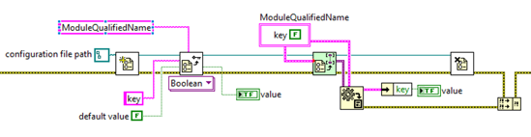
Example of Config Management Simplest form
Manually import from pre-defined source
Notes:
Potential race conditions or locked files (parallelisms)

Slide 5
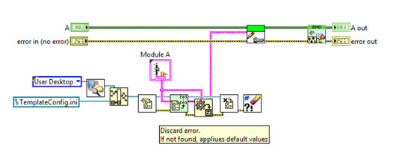
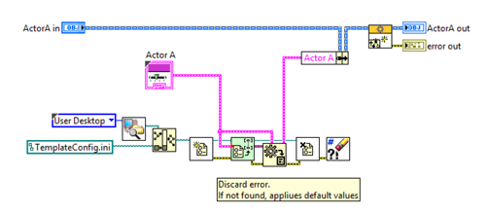
Example of Config Management Templates
Notes:
Abstract the tasks that are repeated often, but:
Still potential race conditions or locked files (parallelisms)
Filepath outside source control
How do you Unit Test this? (Insert a Boolean flag to toggle test case with different values?)
Strays away from the SRP

Slide 6
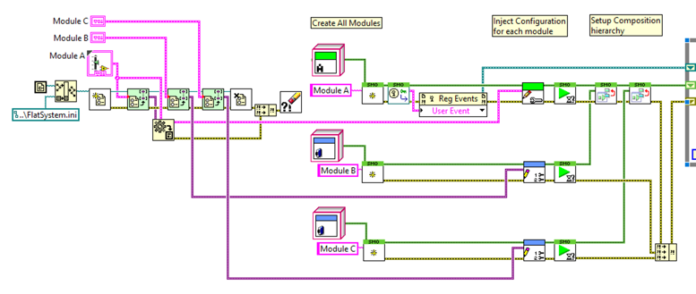
Example of Config Management Global read and inject at object creation
Notes:
No race conditions or locked files
Starts to resemble a singleton implementation where a Manager is responsible for the accessing of file and DB (addresses SRP concerns)
This involves a public Write configuration method.
Config code needs to be copied in dev, test and production code.

Slide 7
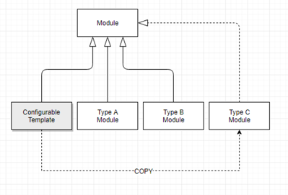
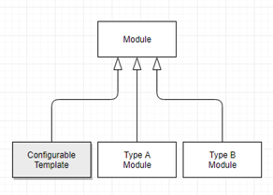
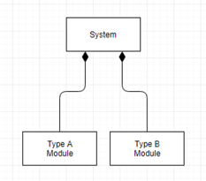
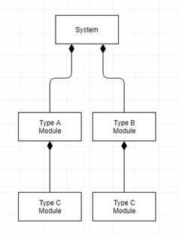
Emerging Patterns
Template approach
Notes:
1st Pattern emerges:
Works well for a single project or for components that will use the same approach.
Careful to avoid race conditions when accessing same resource.

Slide 8
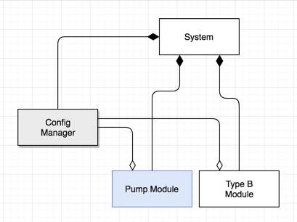
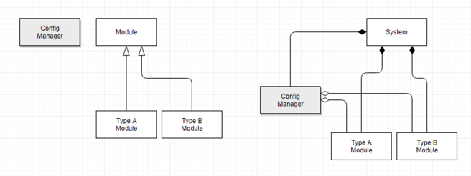
Emerging Patterns
Dependency-injection
Notes:
2nd Pattern emerges:
CfgManager singleton which is used by dependencies through aggregation
Single-Responsibility Principle (CfgManager can be optimized to do what it does)
Avoid race conditions in accessing the data
Easy to configure, maintain and extend the ConfigManager with time.

Slide 9
Definition “Configurable” Configuration Manager ??
Developer can inject a different configuration into CfgManager at instantiation.
Serialization algorithm(s)
Encoding, encryption, validation
Delimiters and specific file/registry formats
We’ve all built those tools (many times over). Why do we keep rebuilding them?
Customer uses a format that is not already what my framework provides…
Customer does not want to reuse my framework, for reason X Y Z…
My {CEO/CFO/CTO/CMO} wants to “own” everything we do (increases acquisition value of company, diminishes audit risk assessments, etc.)
I don’t have time to create a framework-agnostic reuse component, so I’ll do that later.
(…)
Notes:
(Make a Reference to Derek’s presentation about how we’re bad at open source)

Slide 10
Design & Architecture Considerations Desired Properties for a Config Manager
Simple API
Framework-agnostic
Modular, extensible
Handles complex composition hierarchies (system architecture)
Performs in IDE, Automated Tests or Production
Allows multiple configuration schemes to work together
Enhances Testability (empowers the unit tests)
Configurable
Notes:
When developing a reuse tool, try first to establish your goals before developing the solution.

Slide 11
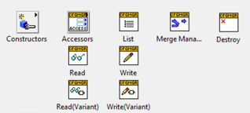
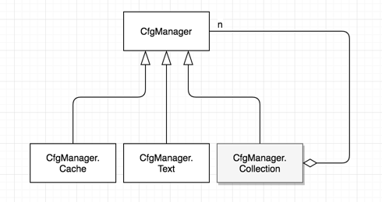
Simple API
Read and Write (by Key-Value Pairs or Variant)
List all keys
Merge Managers into a Collection of Managers
Notes:
This is the *abstract class which provides an interface to our objects.
Not completely abstract:
- Cache (In-Memory) Cfg Manager is included. It consists of a singleton wrapping a variant-attribute dictionary.
- Collection is essentially a list of CfgManagers, which is produced by a merge of multiple managers.
Also comes with a CfgManager.Text for a simple KVP implementation (mainly for showing how to extend the framework to more standard text-based configuration formats. We’ll see that a bit later in this presentation.

Slide 12
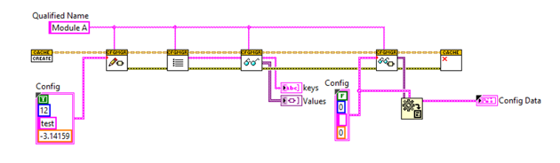

Framework-Agnostic
Simple API
Handles Key-Value Pairs or Variant
Ready to embed in your favorite framework
Haven’t you seen this pattern a gazillion time?
Notes:
Later in this presentation, I will show:
Actor Framework integration
DQMH Template
JKI State Machine Objects integration
Obviously, there is no lack of “Framework-Agnostic” code out there… First, let’s see what are the bells and whistles of this CfgManager.

Slide 13
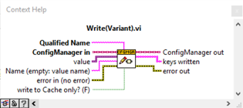
Composition Hierarchies
System
System.ModuleA
System.ModuleA.ModuleC
System.ModuleB
System.ModuleB.ModuleC
Using Fully Qualified Name ensures uniqueness of all key-value pairs
Notes:
Supports namespacing through Qualified Names.

Slide 14
Empowers Unit Tests
DEMO (Empowering Unit Tests)
Example Code:
“A- Empowerihng Unit Tests” folder
Notes:
Show examples with Cache configuration manager that drives unit tests (LV 2014 – Example A in lvproj)
Three examples:
1 & 2: Different configurations, single test
3: Multiple tests with restarting process in-between configuration changes.
++++++++++++++++
Injecting diffrerent configurations at test time cannot be done as easily if the object reads config by itself.
Needs a way to INJECT CONFIG into object.

Slide 15
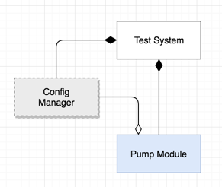


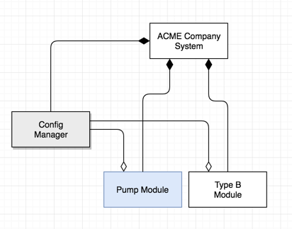
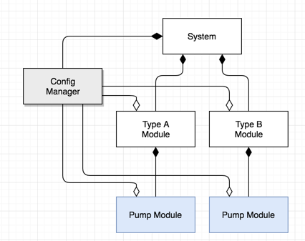
Layered Configuration Schemes
Notes:
Modules often have different configurations based on the context:
Default Factory configuration (ex: standalone pump)
Range of Test Environment configurations
System-specific configuration (ex: pump in a thermal management module)
Customer-specific configuration (ex: pump PID optimized for water vs oil)
Multiple Pumps (what if A & B don’t use same config source.)

Slide 16
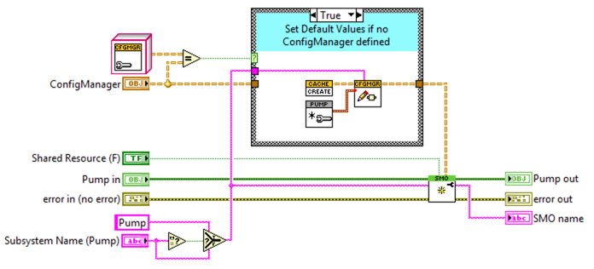
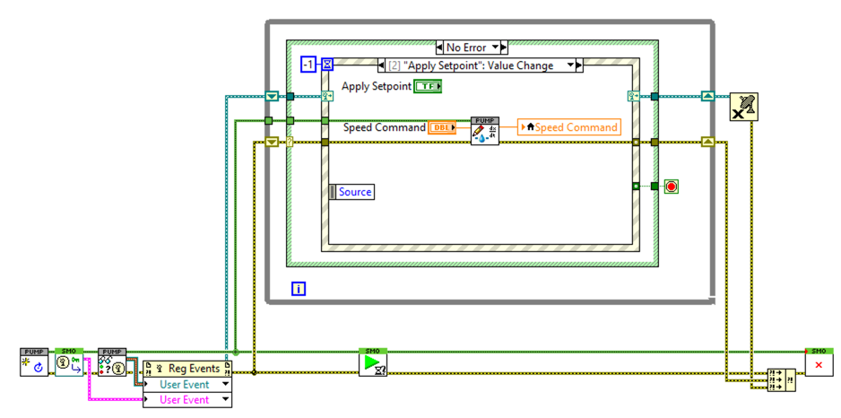
Layers: Stand-Alone Module
Set Default Values in Cache Configuration
Example Code:
“B- Layered Schemes” folder
Notes:
Collection of Configuration Managers

Slide 17
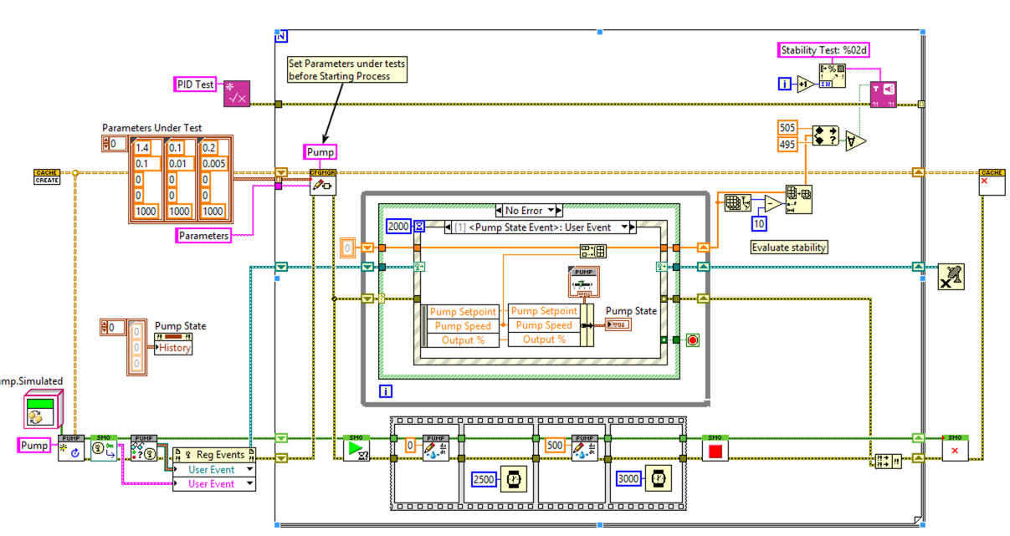
Layers: Unit Testing
Use Cache Configuration externally to inject initial test conditions.
Example Code:
“B- Layered Schemes” folder
Notes:
Using an externally-defined Cache configuration:
- Overrides the object’s default parameters

Slide 18
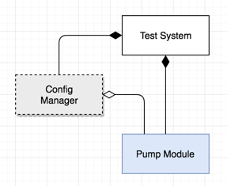
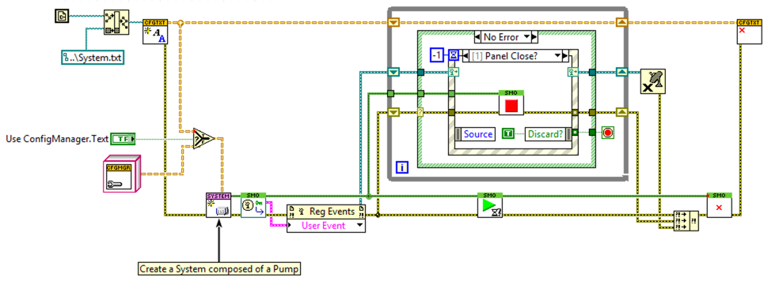
Layers: System Integration
System-defined configuration is injected in dependency
Example Code:
“B- Layered Schemes” folder
Notes:
System Defines
- Overrides the object’s default parameters

Slide 19
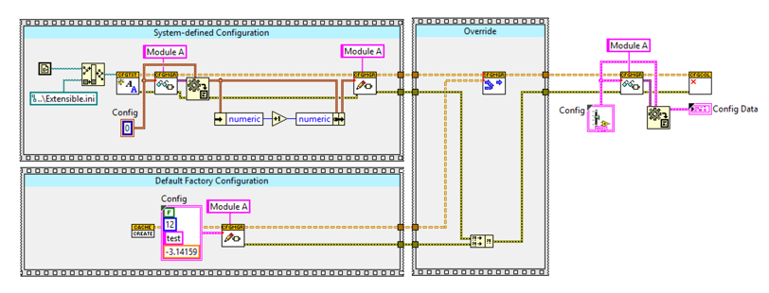

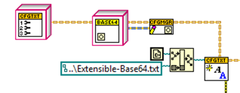
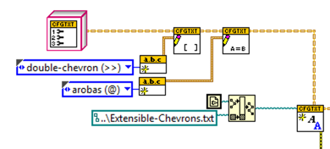
Modular & Extensible, Configurable
Example Code:
“C- Extensible & Configurable” folder
Notes:
1- Example showing how ACME System-defined configuration will override the Default System Config that was defined when developing the project in IDE…
2- (show examples with different Serializers, delimiters, encoding, etc.)
Default ConfigManager.Text
Using Base64 Encoding for the values (encoding is useful if user inputs are localized)
SECTION delimiter & Key-Value delimiter.

Slide 20
Code Overview Under the hood
(Let’s peak under the hood)
Notes:
- Merge Managers

Slide 21
Integration Examples I said framework-agnostic, right?
The goal is to facilitate management of configuration in complex systems.
Notes:
- show AF integration as an extension of Actor class
- show Configurable DQMH template
- show JKI SMO integration as a core SMO Attribute

Slide 22
Links and References
This Presentation
https://github.com/francois-normandin/CfgManager_CLASummit2018
LabVIEW Open Source Project on GitHub
https://github.com/LabVIEW-Open-Source
Configurable Actor Example:
https://github.com/LabVIEW-Open-Source/configurable-af-example
Configurable DQMH Template:
https://github.com/LabVIEW-Open-Source/configurable-dqmh-example
JKI State Machine Objects:
https://github.com/JKISoftware/JKI-State-Machine-Objects

